Slide 1






EMOTION
DETECTION
CV PROJECT
Presented By
SARTHAK MAHAPATRA
2K19/EE/223

Slide 2





LIBRARIES USED
CV PROJECT
OpenCV is open source library for the computer vision .It provides the facility to the machine to recognize the faces or objects.
NumPy is a library for the Python programming language, adding support for large, multi-dimensional arrays and matrices, along with a large collection of high-level mathematical functions to operate on these arrays
It is a software library written for data maipulation and analysis.
It is an open-source software library that provides a Pythgon interface for artificial neural networks.
Matplotlib is a plotting library for the Python programming language and its numerical mathematics extension NumPy. It provides an object-oriented API for embedding plots into applications using general-purpose GUI toolkits.

Slide 3






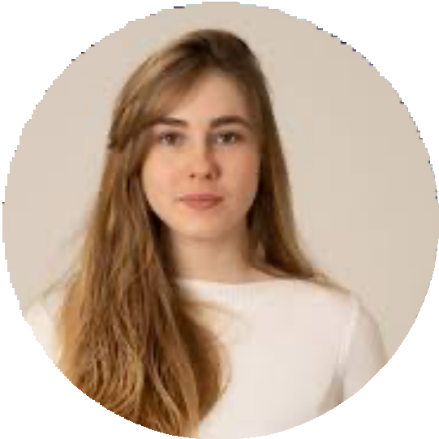
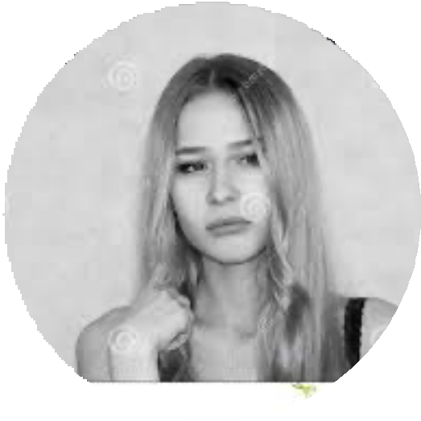

TYPES OF EMOTIONS
STUDIO SHODWE

Slide 4
FLOW OF THE PROJECT
CV PROJECT
First , we download the training data via the wget command. Then we unzip the training data using the unzip command.
Now, its time to import all the necessary libraries like numpy, pandas, opencv,keras, tensorflow, matplotlib.
The pre-trained MobileNet model is then loaded with its input shape set to (224,224,3) and its top layers removed.
A new model is then created by adding a Flatten layer and a Dense layer with 7 output units, one for each emotion. The input to the new model is set to the input of the pre- trained model and the output is set to the output of the new Dense layer.
The training and validation datasets are created using ImageDataGenerator with rescaling, zooming, shearing, and horizontal flipping for the training dataset.

Slide 5

FLOW OF THE PROJECT
CV PROJECT
The plotImages function is defined to plot a batch of images from the training dataset to visualize the images in the training data generator.
The model is then trained using fit_generator.
The best model is then loaded using load_model and the history of the training process is plotted using matplotlib.
Finally, an image is loaded from the training dataset, its prediction is made using the trained model, and the output is printed along with the image.

Slide 6






Thank You
CV PROJECT

